Slide 1
Music Recommendation System
Under the supervision of Prof. Ruchika Malhotra
Made By:-
Vaibhav Varshney (2K18/CO/382)
Vikas Yadav(2K18/CO/386)

Slide 2
OBJECTIVE
The aim of this project is to implement, analyse, and evaluate the Popularity Based and Collaborative Based Filtering Models that offer recommendations based on interactions between different users and songs.
Music Recommendation Systems work on various algorithms and techniques that provide personalized song recommendations on the basis of the characteristics of songs heard by the user. This functionality helps users to discover new songs of their taste and thus improving user-application interaction.
Tasks that we carried out
Pre-processing
Popularity Filltering Model
Collaborative Filtering Models i.e. Item-Item and User-User based model
Evaluated the performance measures for these models.
Compared the use of different methodologies for estimating the similarities among songs

Slide 3
DATASET DESCRIPTION
The ‘Million Song Dataset’ was chosen for performing this work. It is a freely available dataset, prepared by The EchoNest. It contains an aggregation of metadata for almost a million songs, and the user listens to history. The original dataset carries a size of 280 GB, and therefore to simplify this task, we have used a subset of this dataset, which contains 10000 songs.
The dataset has two sections; the first consists of a collection of song_id, title, release, artist_name, and year.
The second section of the dataset holds data on the history of songs heard by users. It stores user_id, song_id, and count of the number of times that particular user has listened to that specific song with a unique song_id.
Research Variables
The collective research variables available for carrying out this work are:-
song_id
title
release
artist_name
year
user_id
count

Slide 4
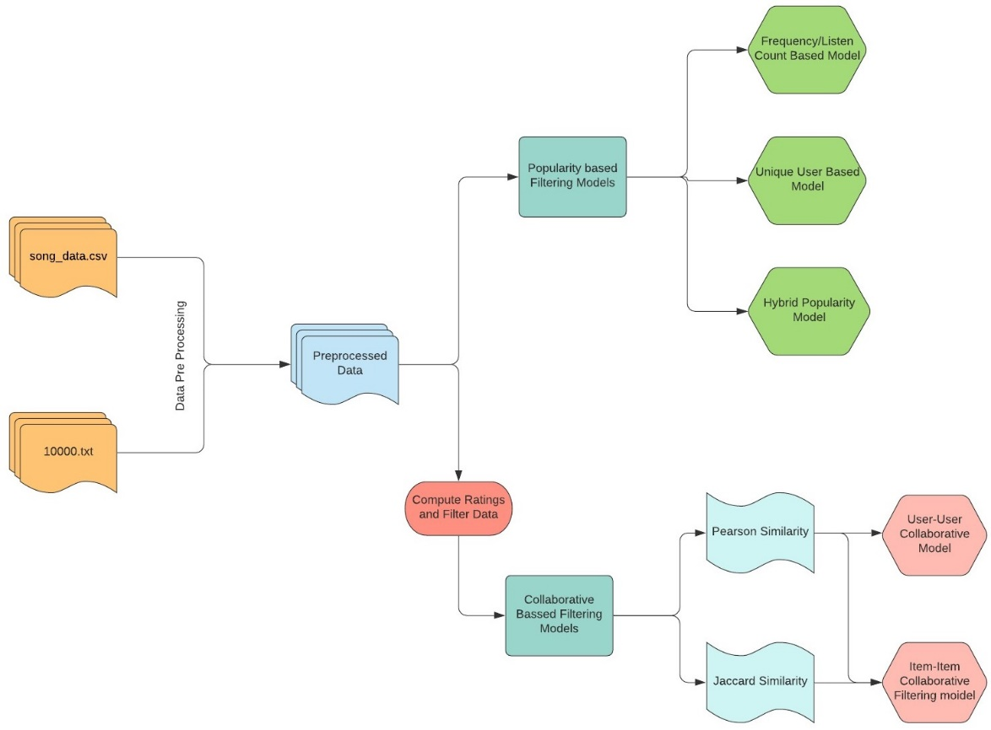
Experimental Design
Firstly the data is pre-processed and is fed into two models namely the Popularity Based Filtering and Collaborative Based Filtering models.
Popularity Based Filtering Model has three subtypes namely:-
Frequency/Listen To Count Popularity
Unique User Popularity
Hybrid Popularity
Before the data is fed into CF model the data has been filtered and rating system has been applied to all the tuples in the dataset.
Two types of CF model used are:-
User-User Based
Item-Item Based
Pearson and Jaccard Similarity have been used to evaluate the similarities amongst users and various songs.
The results are computed and various measures have been calculated to estimate the performance of the system.

Slide 5
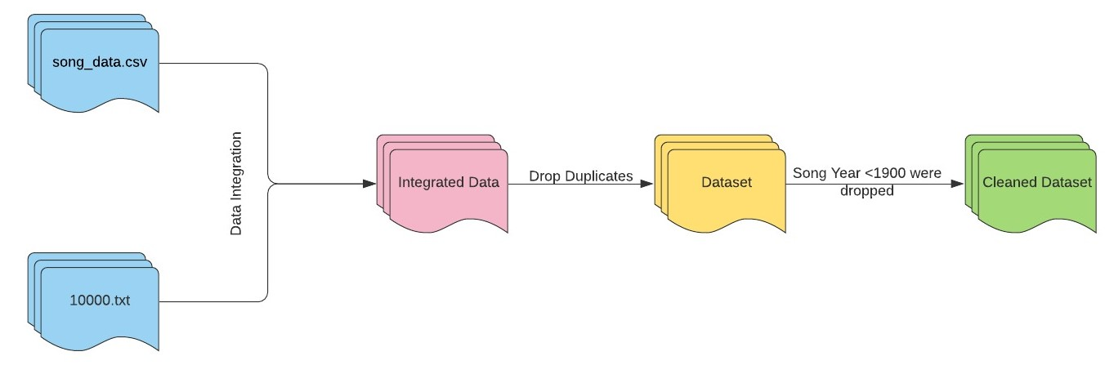
DATA PRE-PROCESSING
Data Integration
The two sections of the dataset are integrated together and grouped into a single data frame by performing inner join on the song_id attribute. After the
successful integration, the data frame
now contains 20,86,946 rows and 7 columns.
Data Cleaning
a) Duplicate rows were dropped from the
dataset to decrease the chances of inaccurate
prediction of recommendations by the
system.
b) Songs having a year of release less than
1900 were removed from the dataset as they
would have been of least interest to the users.
c) Also, many songs were present in the dataset, which had a year of release as 0. So to remove
such outliers as well, this process was carried out.

Slide 6
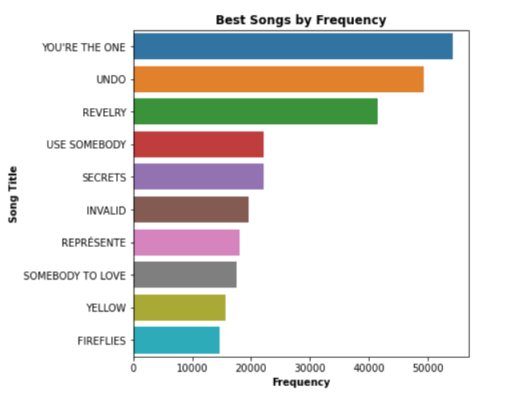
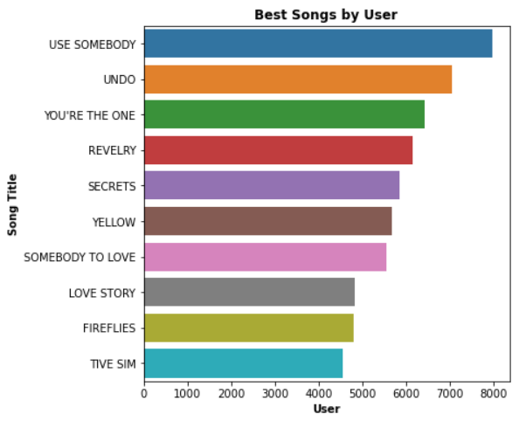
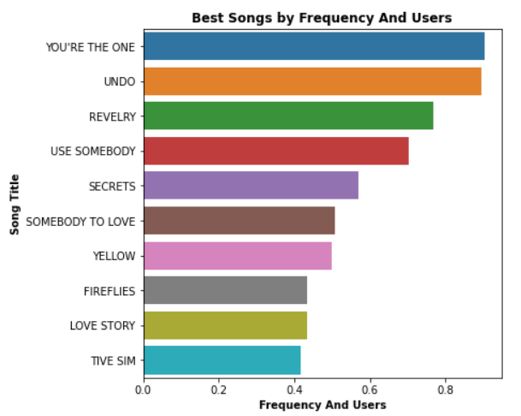
POPULARITY BASED FILTERING
This kind of filtering is based on the concept of providing the most popular songs to the users. The popularity of a song is determined on the basis of various factors like the number of unique listeners of the song or the number of times particular song has been heard.
For this study, we have classified the popularity into three types:-
Frequency/Total Listen Count
In this type of popularity-based filtering, the popularity of songs has been established on account of the number of times a certain song has been heard.
Unique Listeners of Song
In this type of popularity filtering, our focus is more on the unique listeners of songs rather than the listen count of songs.
Hybrid Popularity
To ensure that suggestions offered by the filters have equal weightage for unique users and listen to count, a hybrid version of the above two popularity filters has been created

Slide 7
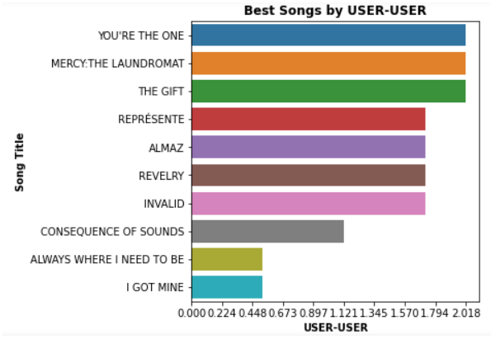
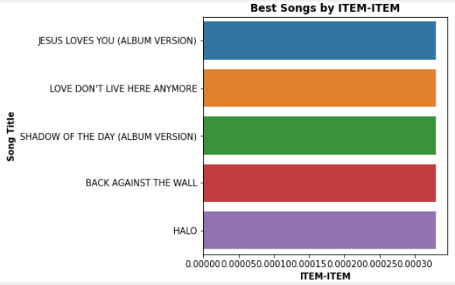
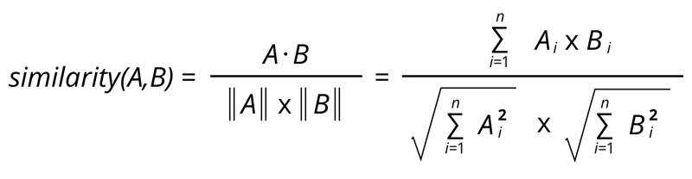
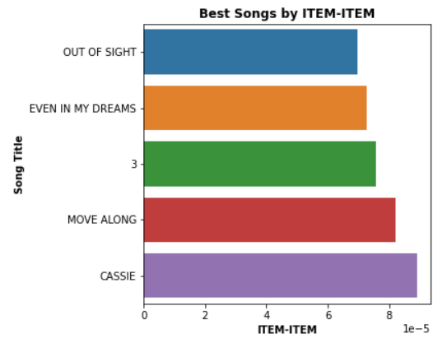

COLLABORATIVE BASED FILTERING
User-User CF Using Pearson Correlation
Item-Item CF Using Jaccard Similarity
Collaborative based filtering procedures for music recommendation systems are methods that are entirely formulated upon the former interactions amongst the users and the songs
Methods used for calculation of correlations are:
Pearson Similarity
Jaccard Similarity
Similarities has been evaluated amongst the songs and users and the recommendations of both the models are shown in the figures.
Item-Item CF Using Pearson Correlation

Slide 8
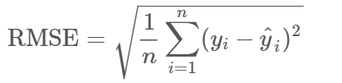
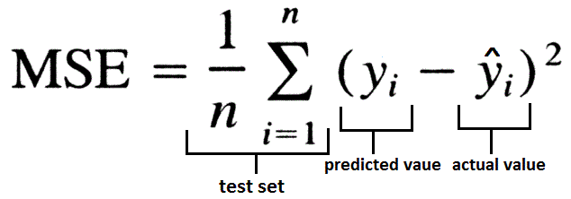

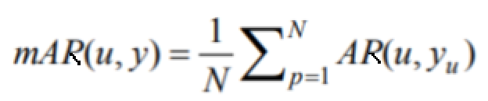
EVALUATION METRICS
In our study, we have used four different performance measures to analyse the different models of collaborative filtering
Performance Measure | Formula
Root Mean Square Error(RMSE)
Mean Square Error(MSE)
Mean Average Precision(mAP)
Mean Average Recall(mAP)

Slide 9
RESULT AND ANALYSIS
User-User Based
Item-Item Based Using
Pearson Similarity
Item-Item Based Using
Jaccard Similarity
Evaluation Metrics | Value
Root Mean Square Error (RMSE) | 1.45541394224723
Mean Square Error (MSE) | 2.2412263204265526
Mean average Recall (mAR) | 0.6488970000000001
Mean average Precision (mAP) | 0.6488970000000001
Evaluation Metrics | Value
Root Mean Square Error (RMSE) | 0.5329645142665033
Mean Square Error (MSE) | 0.3105393164594553
Mean average Recall (mAR) | 0.643342
Mean average Precision (mAP) | 0.643342
Evaluation Metrics | Value
Root Mean Square Error (RMSE) | 0.6414081368436308
Mean Square Error (MSE) | 0.4395905011392373
Mean average Recall (mAR) | 0.6666700000000001
Mean average Precision (mAP) | 0.6666700000000001

Slide 10
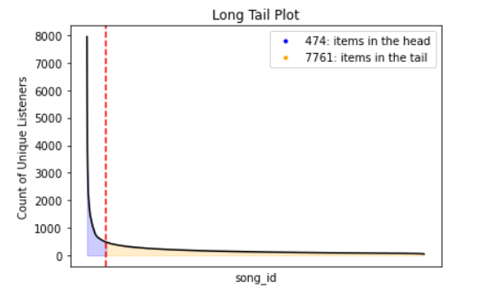
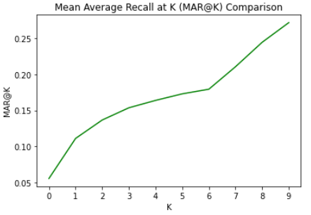
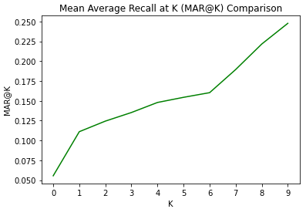
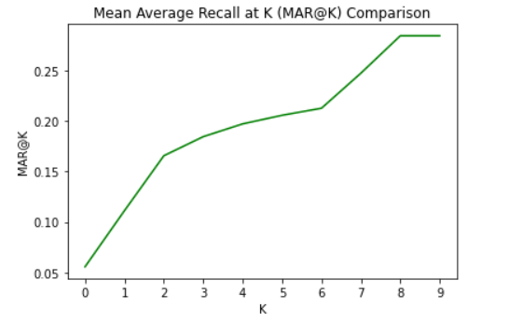
RESULTS AND ANALYSIS
LONG TAIL PLOT FOR
POPULARITY BASED
FILTERING
MEAN AVERAGE RECALL AT K
COLLABORATIVE FILTERING
(USER-USER BASED)
MEAN AVERAGE RECALL AT K
COLLABORATIVE FILTERING (PEARSON SIMILARITY ITEM-ITEM BASED)
MEAN AVERAGE RECALL AT K
COLLABORATIVE FILTERING (JACCARD SIMILARITY ITEM-ITEM BASED)

Slide 11
CONCLUSION AND FUTURE SCOPE
The authors have implemented a Popularity based model, User-User based, and Item-Item based collaborative filtering models. The Popularity based model performed the worst with no doubt as it couldn’t provide personalized recommendations.
User-User based and Item-Item based models performed considerably better with Item-Item based models performing. This might be due to the fact that relations amongst items are simpler than users. Items are having very small sets of genres while users may have varied tastes, and in real-world contrast, item similarity is more meaningful than the user similarity as songs have some definite set of features/qualities while users have indefinite features and tastes, so it’s always better to find the similarities between songs. This implies that the notion of item similarity is more meaningful than the notion of user similarity.
This project can be improvised by constructing various models using techniques like content-based filtering, collaborative filtering using Matrix Factorization, CRNN models, SVD models, Graphical models that capture the intuitions of feature mapping along with the user and the items and, Hybrid models as well.

